Slide 1
Baseband Attacks:Remote Exploitation of Memory Corruptions in Cellular Protocol Stacks
Ralf-Philipp Weinmann

Slide 2
Introduction
Background
Vulnerability analysis
From bugs to exploits
Impact
Conclusion and Outlook

Slide 3
Introduction

Slide 4
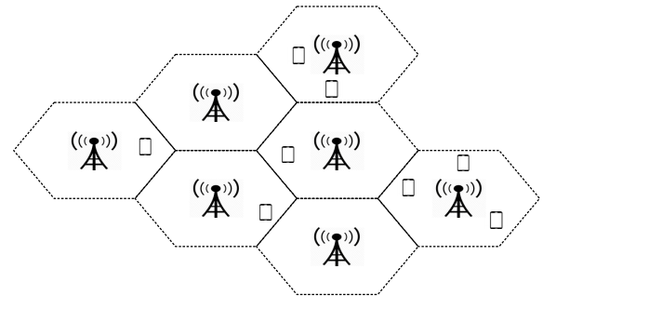
1.cellular networks
Mobile communication network
“Cells” are land areas covered by a base transciever station(BTS).
To cover a large area, the cells are used in junction: A Cellular
Network.

Slide 5
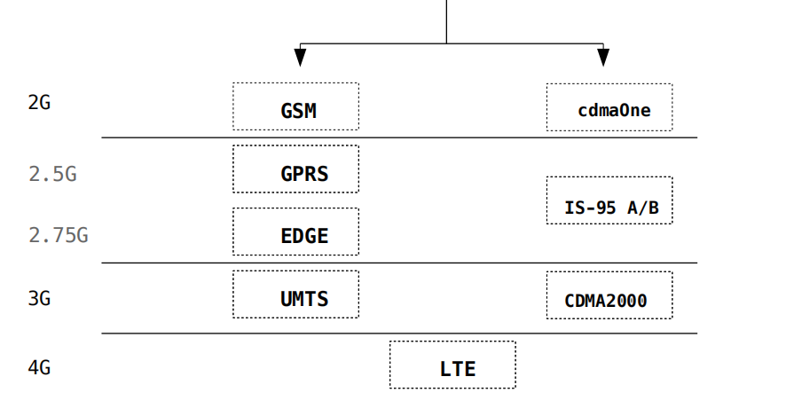
A number of technologies and standards developped.
Mainly two branches: GSM branch and CDMA branch

Slide 6
GSM(Global System for Mobile Communications),全球移动通信系统
GSM通信系统的组成:
移动台(MS)
无线基站子系统(BSS)
交换路由子系统(NSS)

Slide 7
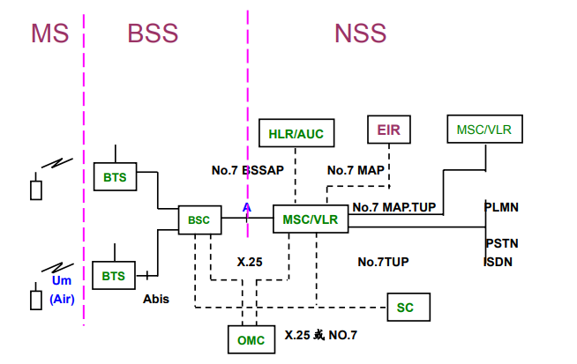
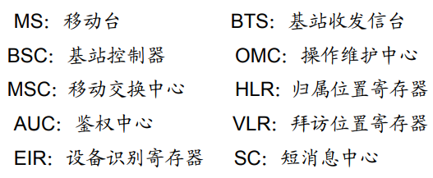

Slide 8
2.The Baseband
A modern smartphone:AP&(baseband processor,Wi-Fi SoC)
The AP(Application Processor) runs your OS and apps
The baseband processor:
Component of the phone in charge of handling communication with the mobile network
Supports a number of standards (GSM, 3G, 4G, 5G, cdmaOne, CDMA2000, ...)
The baseband runs a RTOS.
A communication interface between CP and AP (Application Processor) such as shared memory, serial or interrupts.

Slide 9
Qualcomm owns most of the market.
Qualcomm: Galaxy, iPhone, OnePlus, Pixel, Xperia, HTC, LG, ASUS, Motorola, ...
Huawei: Mate 10, P20, Honor 9, ...
Samsung: Galaxy S6, S7, S8, S9, ...
Intel: iphone X, iphone 8, ...

Slide 10
Background

Slide 11
1.Local exploit and unlocks
“unlock scene”
lock-in model(“network lock”)
handset ——SIM card(IMSI or ICCID)

Slide 12
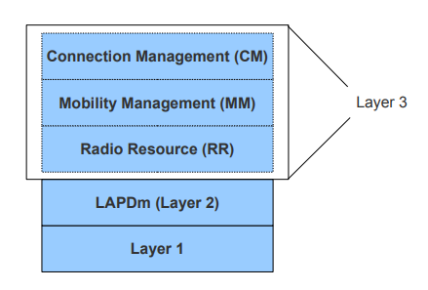
2. GSM layers and information elements
Layers of a GSM software stack running on a MS

Slide 13
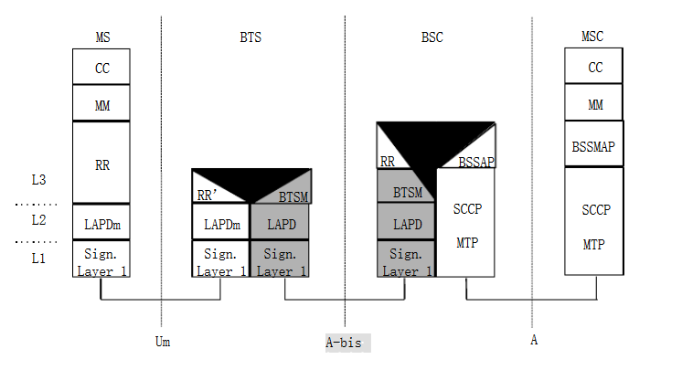

Slide 14
The physical layer(layer 1)
1.GMSK
2.TDMA
3.FDMA
....

Slide 15
The data-link layer(layer 2)
LAPDm(MS和BTS之间消息传递的协议)，是LAPD协议的简化版本。

Slide 16
The layer 3
1.RR(Radio Resource Management)
负责无线连接，主要作用是建立一条专用信道以及越区切换后专用信道的重新连接。
2.MM(Mobility Management)
位置更新：移动性管理，安全性管理
3.CM(Connection Management)
CC(call control) call eatablishment/release
SS(supplementary services) e.g. USSD
SMS

Slide 17
Information Elements(IEs):a layer 3 message
V, T, TV(fixed length)
LV, TLV(variable length)
T(tags) L(length) V(value)

Slide 18
Vulnerability analysis

Slide 19
1. Area of interest
1.The buffer overflow
2.Dangling pointer

Slide 20
2.Classification of bugs found
1.Insufficient length checks
2.Object/structure lifecycle issues
3.Integer overflows/underflows
4.Memory information leaks

Slide 21
3.Issues with dual-mode
In baseband stacks that support both GSM and UMTS,code paths between the two are often shared.

Slide 22
4 .Examples of exploitable bugs found
1.The TMSI is supposed to be always 32 bits long,but a variable length field is used.Sending a longer TMSI caused the baseband stack of iPhones to crash.
2.GSM——RAND(16 byte)
UMTS——AUTN(a variable length IE,in fact 16 byte)
the Qualcomm stack accepts this variable length AUTN challenge in a GSM layer 3 message.

Slide 23
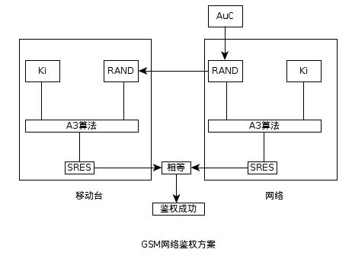

Slide 24
From bugs to exploits

Slide 25
the exploitability of a vulnerability
the auto-answer fuctionality:by sending the command ATS0=n over AT command interface to the baseband.
1.locate the AT command handler for setting the S0 register;
2.load the value 1 into register R0;
3.redirect the execution flow into this function.

Slide 26
Impact

Slide 27
privary-relevant hardware of the telephone
billing issues

